Slide 1

Course Code: MATH 211
Course Title: MATH III
Lecture 1,2 (Complex Number System)
Tazin Tamanna
Lecturer in Mathematics
Department of Science and Humanities
M.Sc. in Applied Mathematics (KU)
B.Sc. in Mathematics (KU)

Slide 2
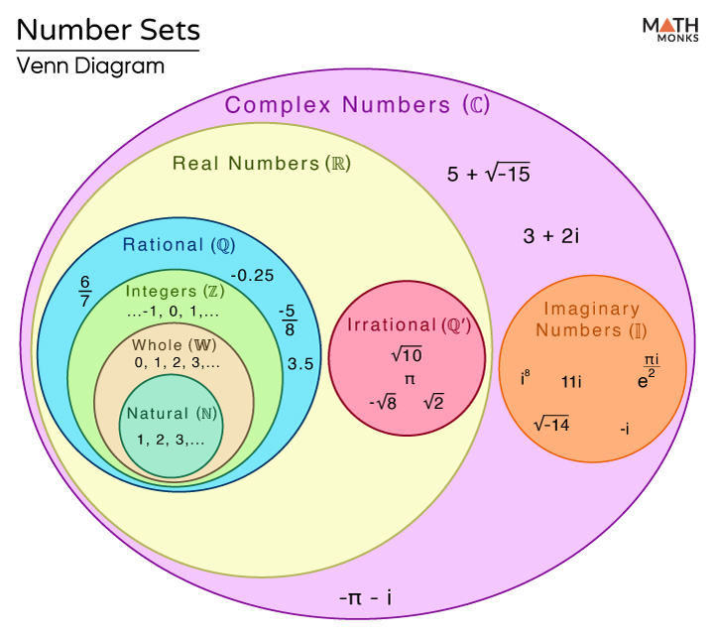
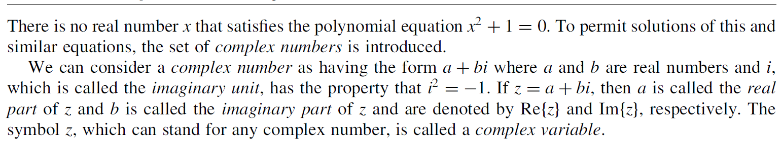
The Complex Number System

Slide 3
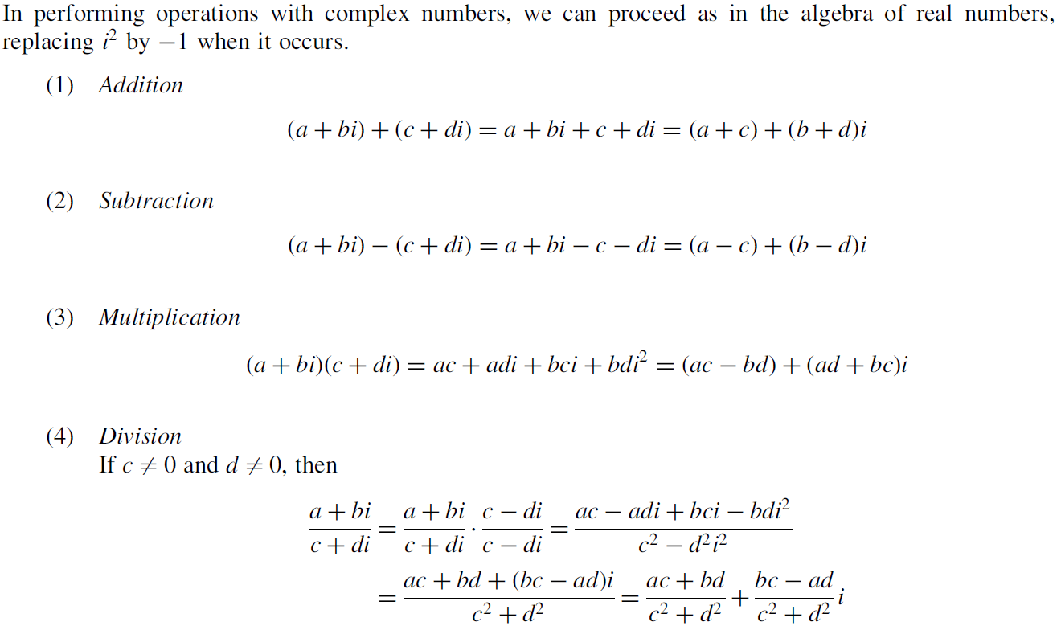
Fundamental Operations with Complex Numbers

Slide 4
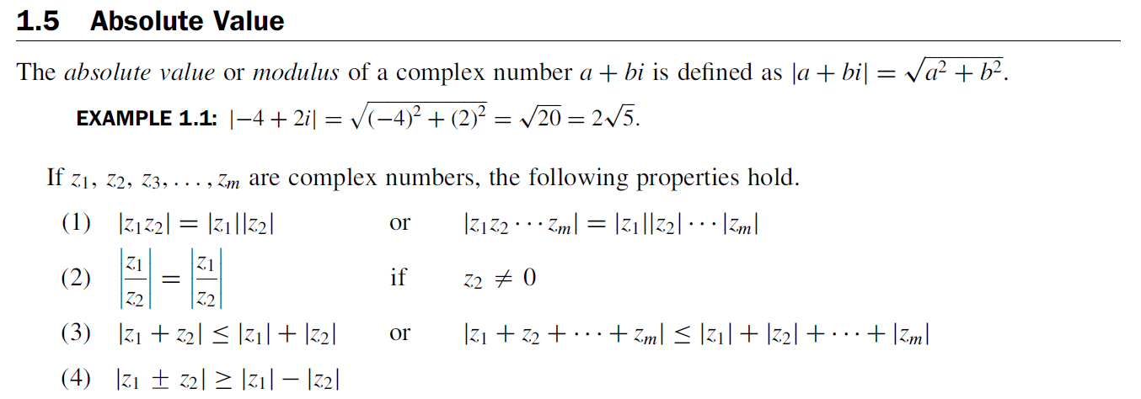
Absolute Value

Slide 5
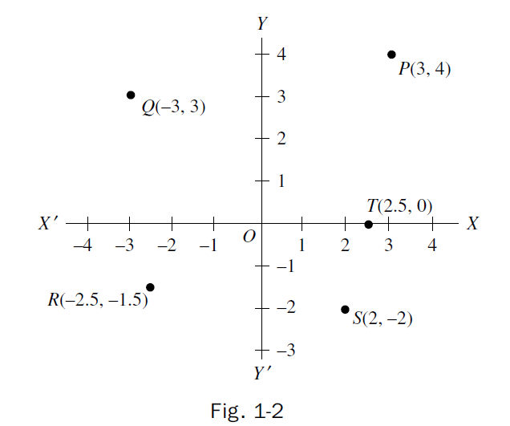
Graphical Representation of Complex Numbers

Slide 6
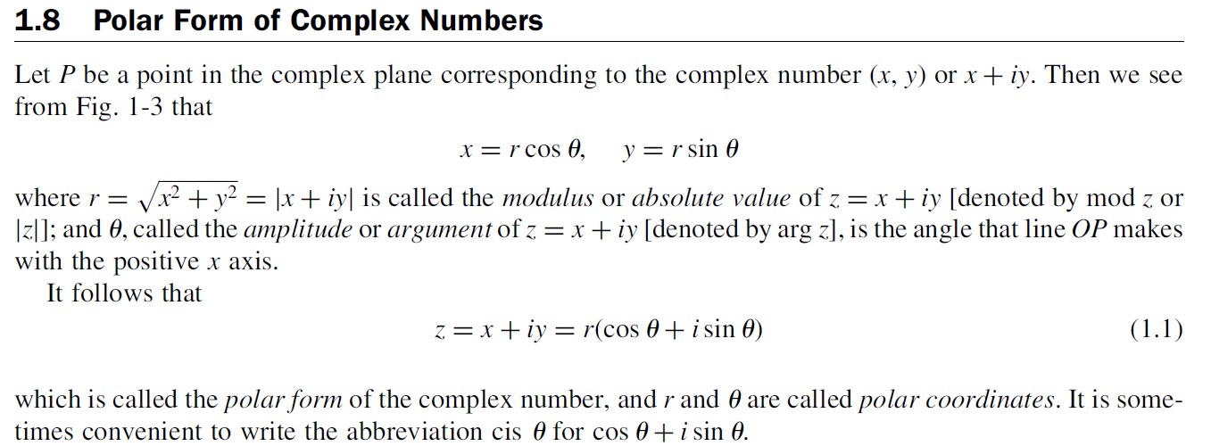
Polar form of Complex Numbers

Slide 7
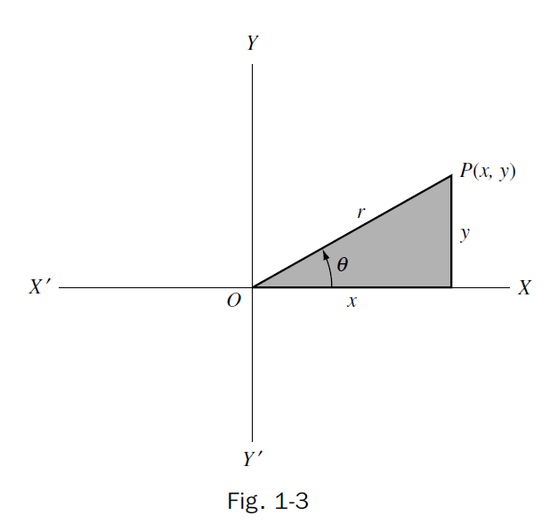

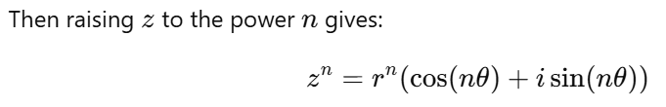
De Moivre’s Theorem
If z is a complex number in polar form:

Slide 8
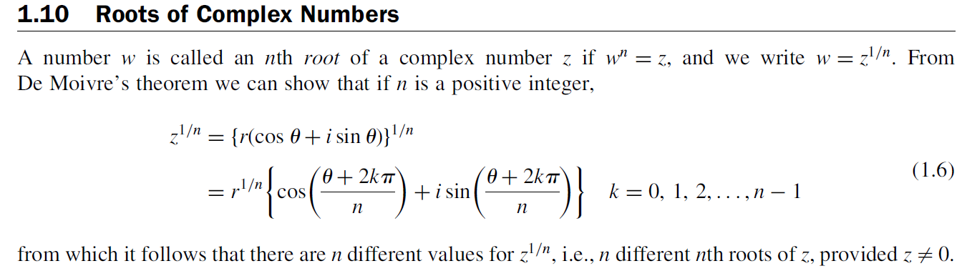
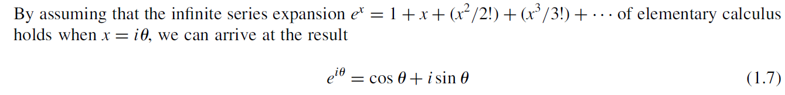
Roots of Complex Numbers
Euler’s Formula

Slide 9
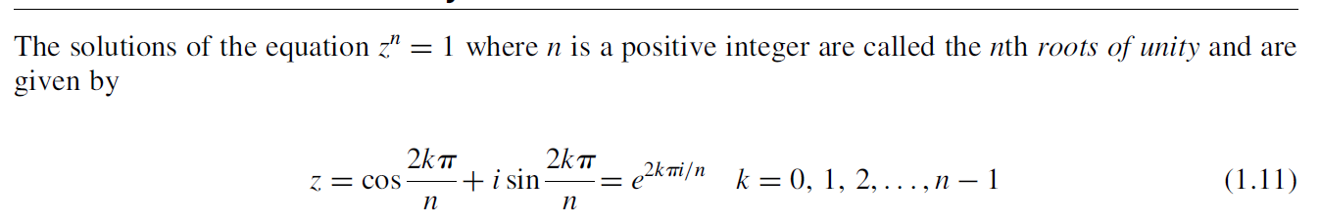
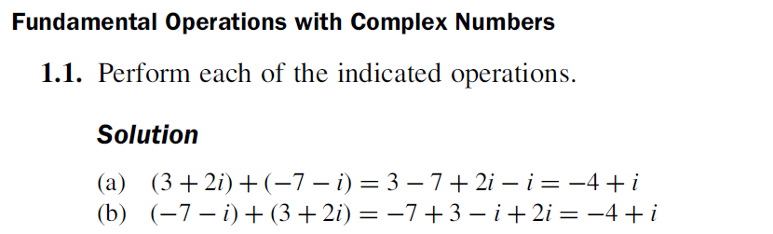
The nth Roots of Unity
Fundamental Operations with Complex Numbers

Slide 10
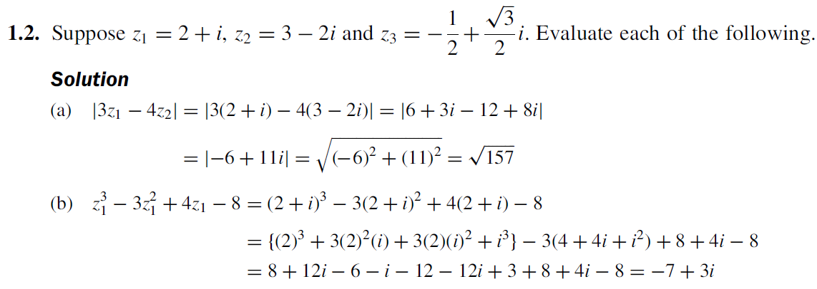

Slide 11
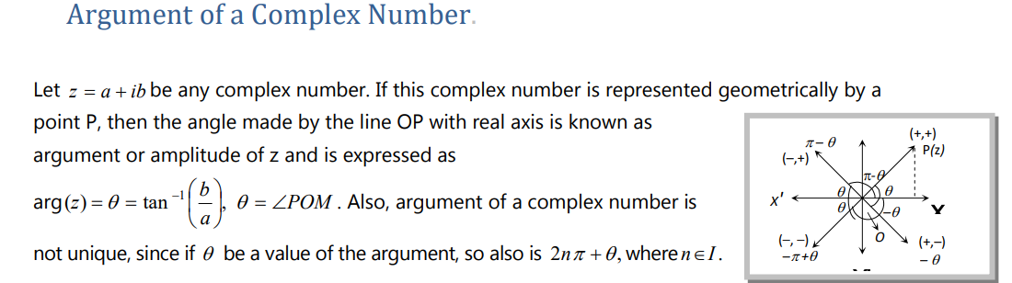
Argument of Complex Number

Slide 12
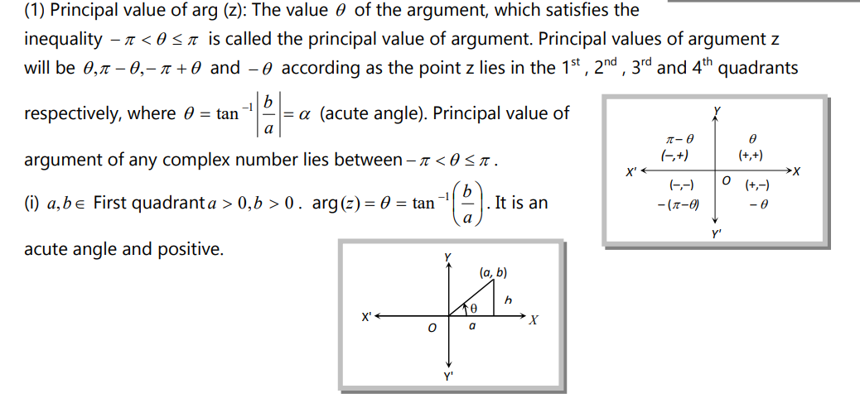
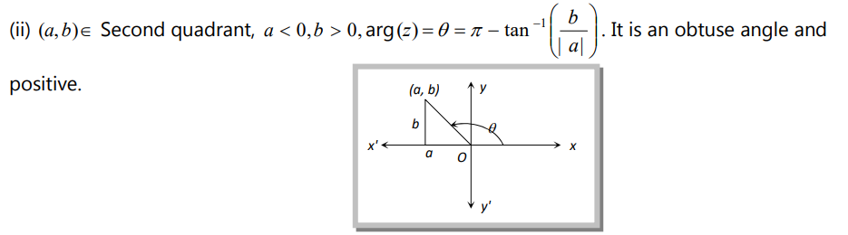

Slide 13
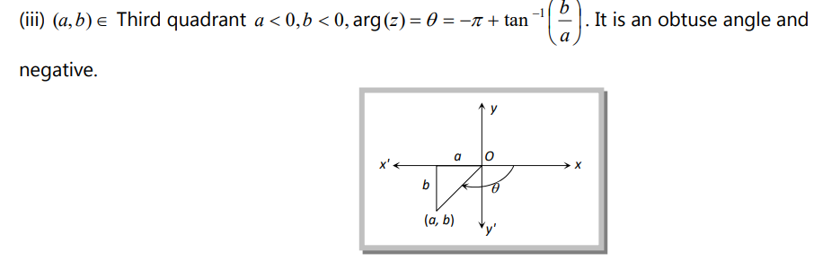
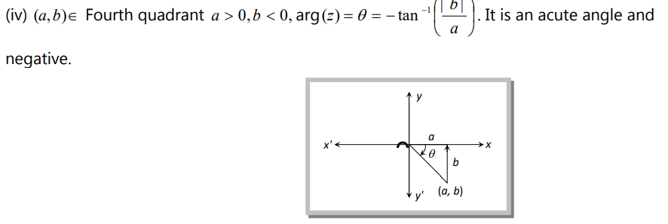

Slide 14
1
Finding Modulus and Argument
Polar form Express
2
3
Finding Roots
Mathematical Problem
4
Finding Solutions
Determine the region
5

Slide 15
Type-I: Finding Modulus and Argument

Slide 18


Slide 20
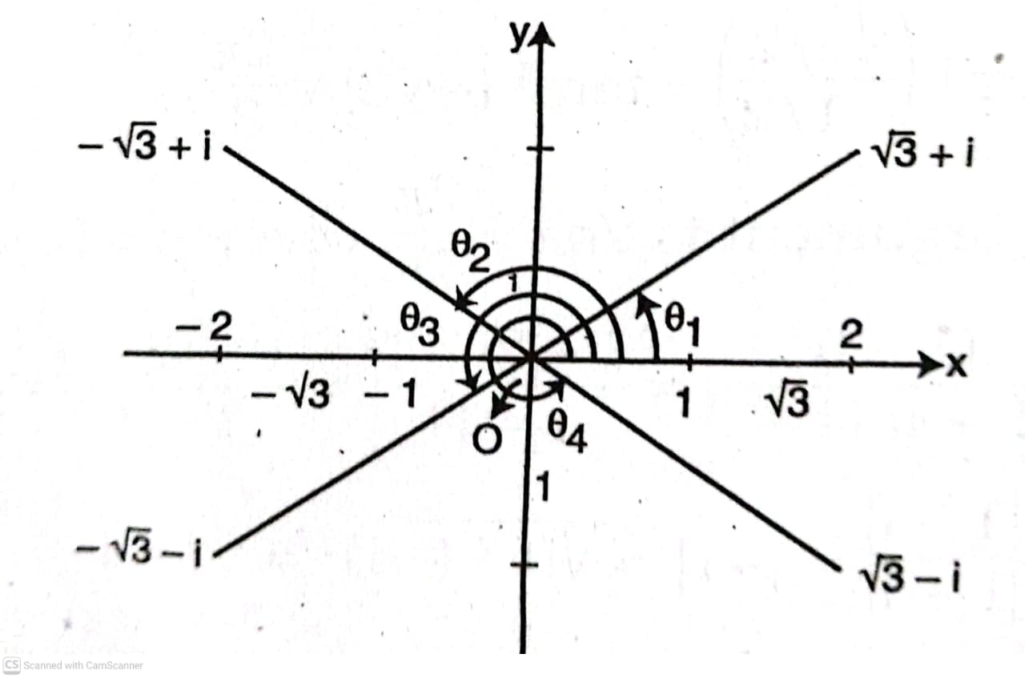

Slide 23
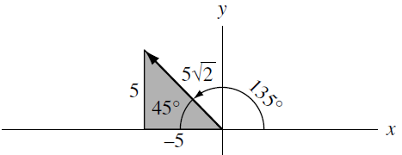
Type-II: Polar form Express

Slide 24
Do Yourself

Slide 25
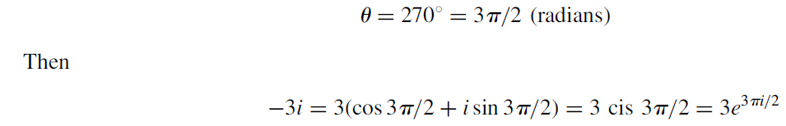
(Ans)

Slide 26
Type –III: Finding Roots

Slide 28
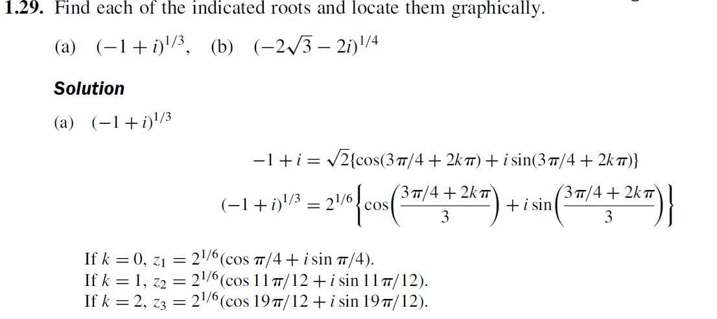
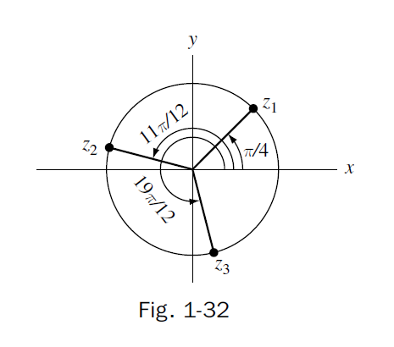
Example 3:

Slide 29
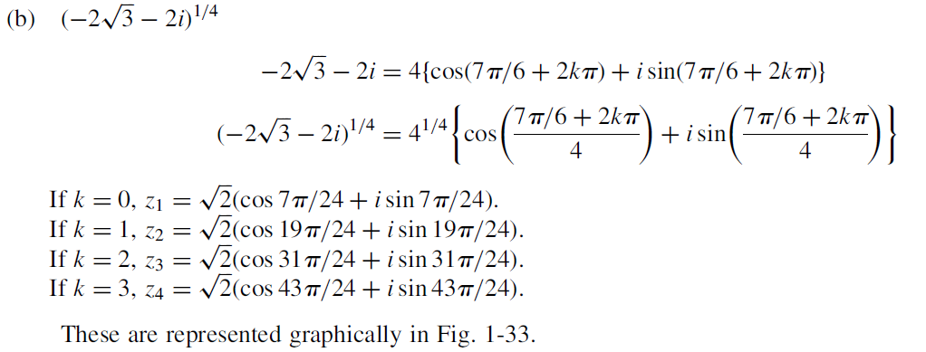
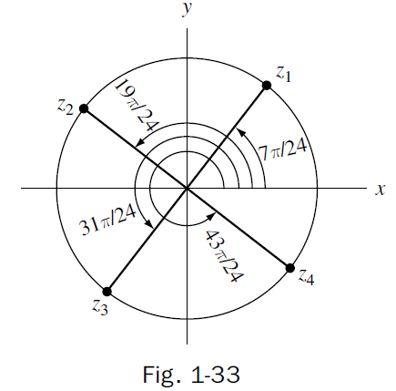
Do Yourself

Slide 30
Type –IV: Finding Solutions

Slide 34
Type V-: Determine the region

Slide 35
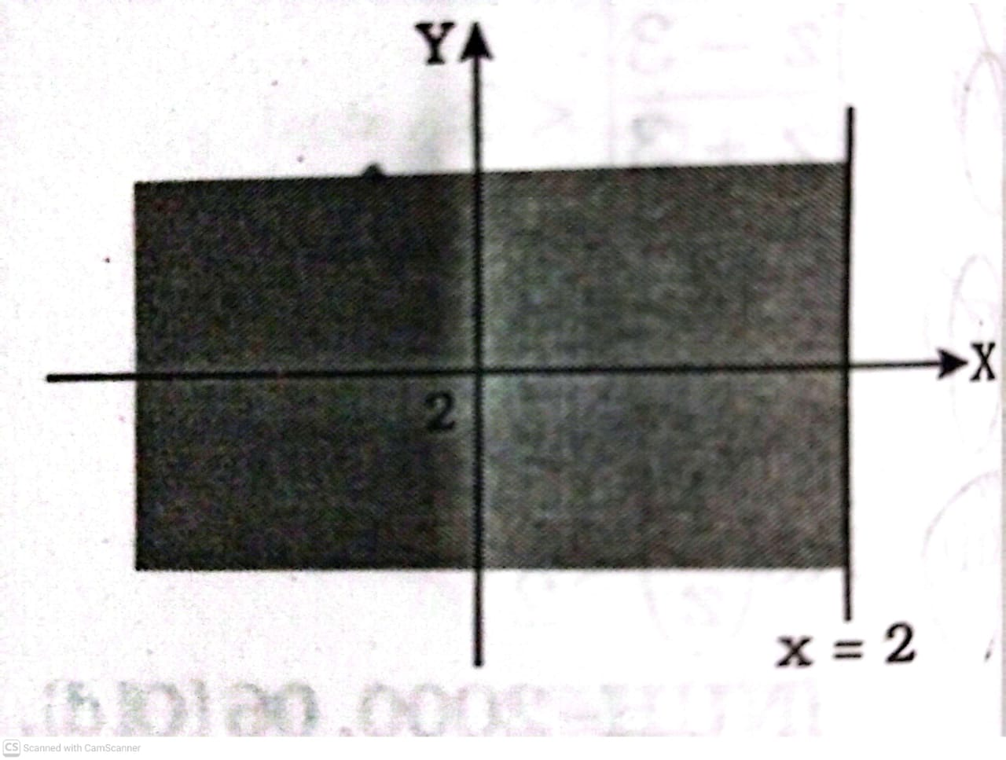

Slide 36
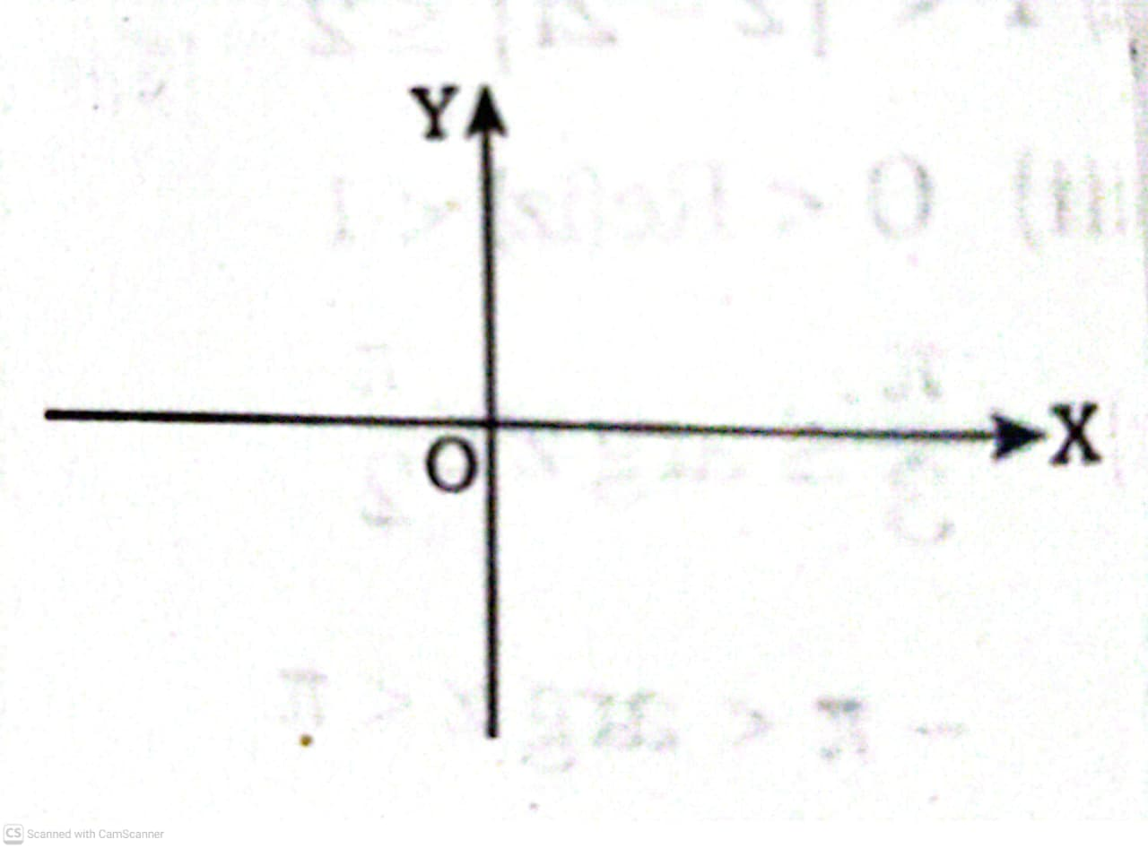

Slide 37
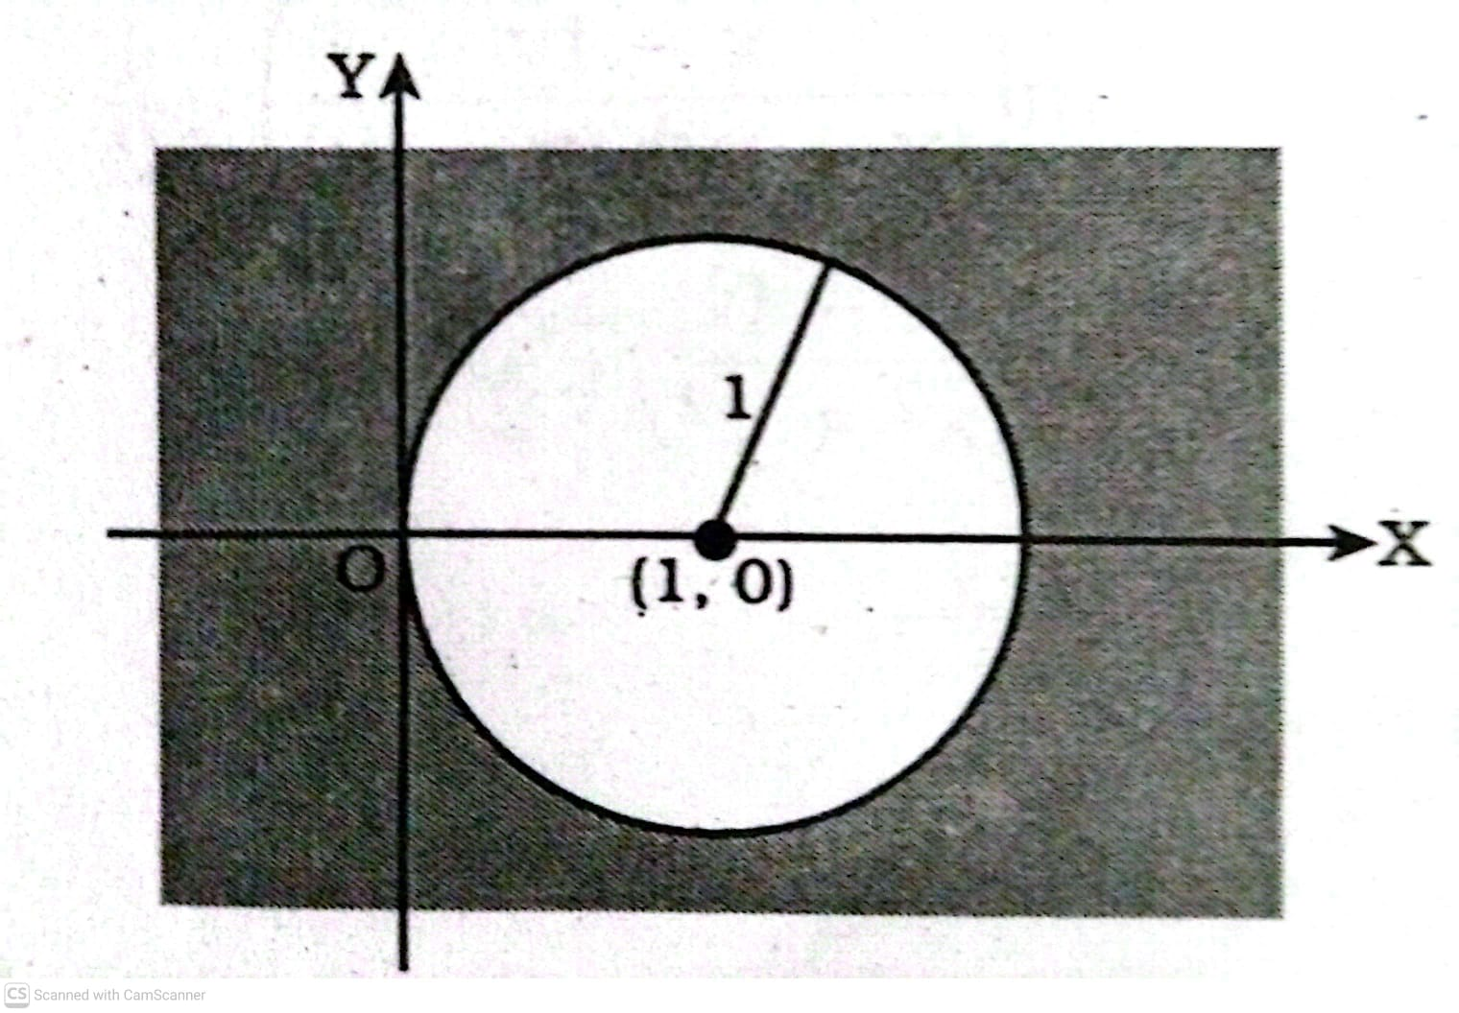

Slide 39
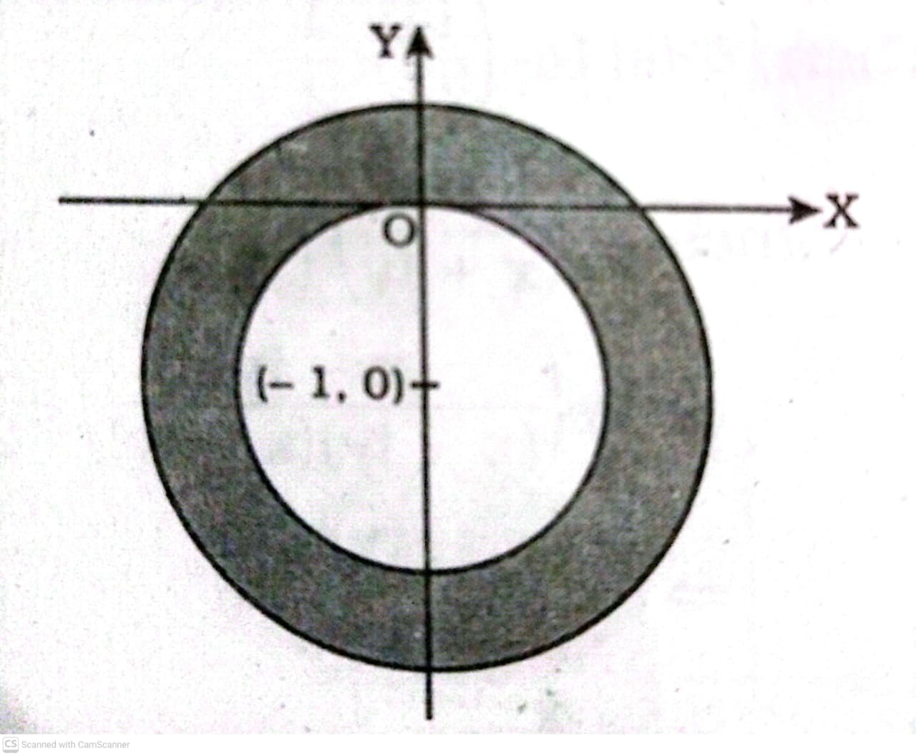

Slide 40
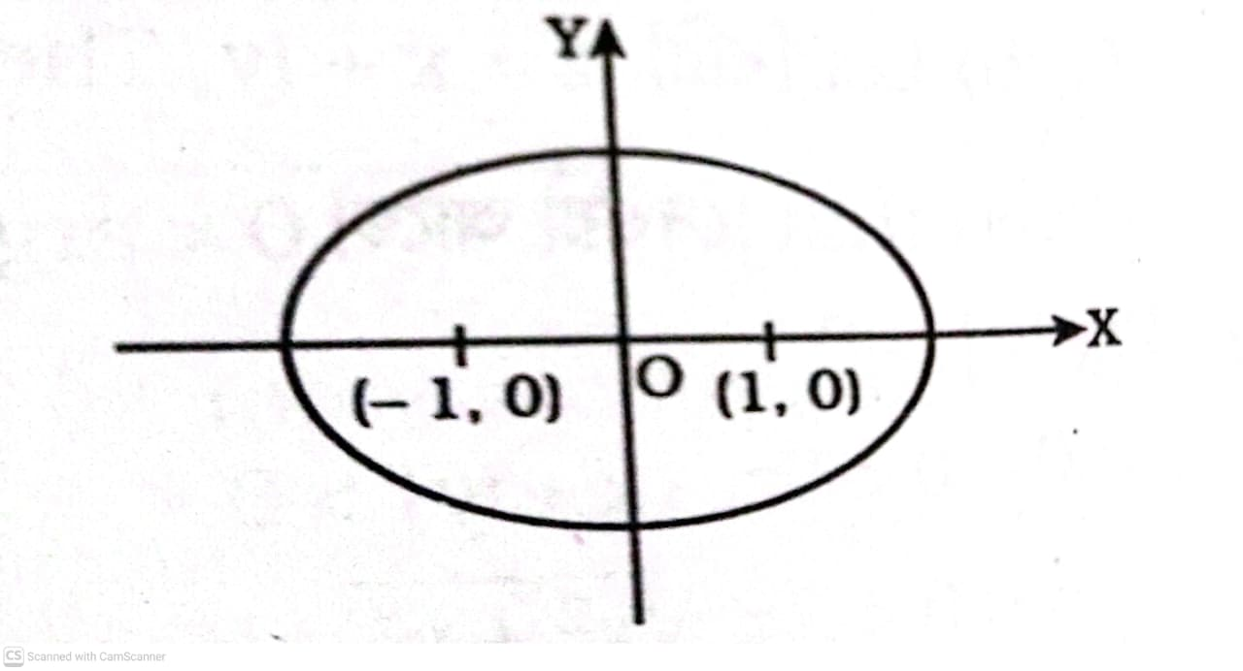

Slide 41
Do Yourself

